Slide 1

Poshan Abhiyan
BY:
C.Samiksha : 1602-20-737-037
Ajay Kumar : 1602-20-737-002
R.Thirupathi : 1602-20-737-031

Slide 2
Motivation:
India’s malnutrition rates have dropped dramatically, the govt. of India has approved the centrally sponsored scheme. The main aim is to generate an application that ensures that each student gets the required amount of nutrients. It aims at helping the government aided schools to manage the food served to each student according to each students nutrition factors.

Slide 3
Description :
The application provides logins for students and the respective in-charges.
This helps to identify the food items and also to calculate the calories present in the image of food item.
The attendance will be given to students after meals are served to them.
The minimum prerequisite calories has in order for each student to have proper nutrition.
A feedback form regarding the food items which were served is provided, which helps make relative changes in the future.

Slide 4
Proposed Solution :
To develop a software application that enables calculation of approximated number of calories served based on the image uploaded as input
The application also enables face recognition based attendance system, it identifies the student whose image is uploaded
This AI based tracker monitors the food being consumed by the students and notifies in case of malnutrition and informs the respective authorities, this help improve the nutrition status of students in government aided schools
The application enables weekly change in the menu of the food being served to the students, thus increasing the dataset.

Slide 5
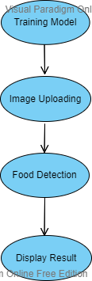
Flow Of Calorie Calculation
Creation of dataset is done by collecting food images
The collected dataset is annotated with the corresponding labels
The yolov8 model was used for training the model
This trained model detects and classifies the items/objects present in the image
So the amount of calories present depends on the image uploaded

Slide 6
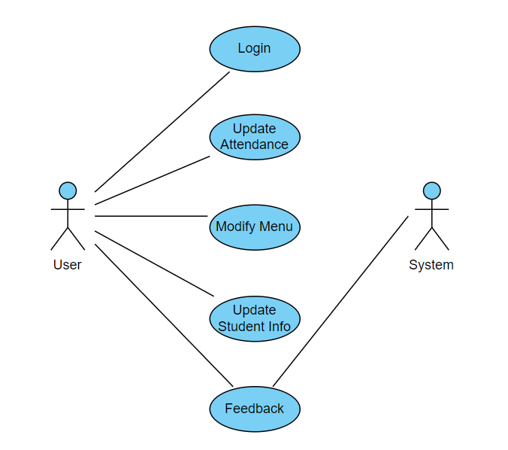
Use Case Diagram

Slide 7
Technology Used :
SOFTWARE REQUIRED:
YoloV8
VS Code
Google Colab
TECHNOLOGIES USED:
-HTML, CSS, JAVASCRIPT, ROBOFLOW, FLASK

Slide 8
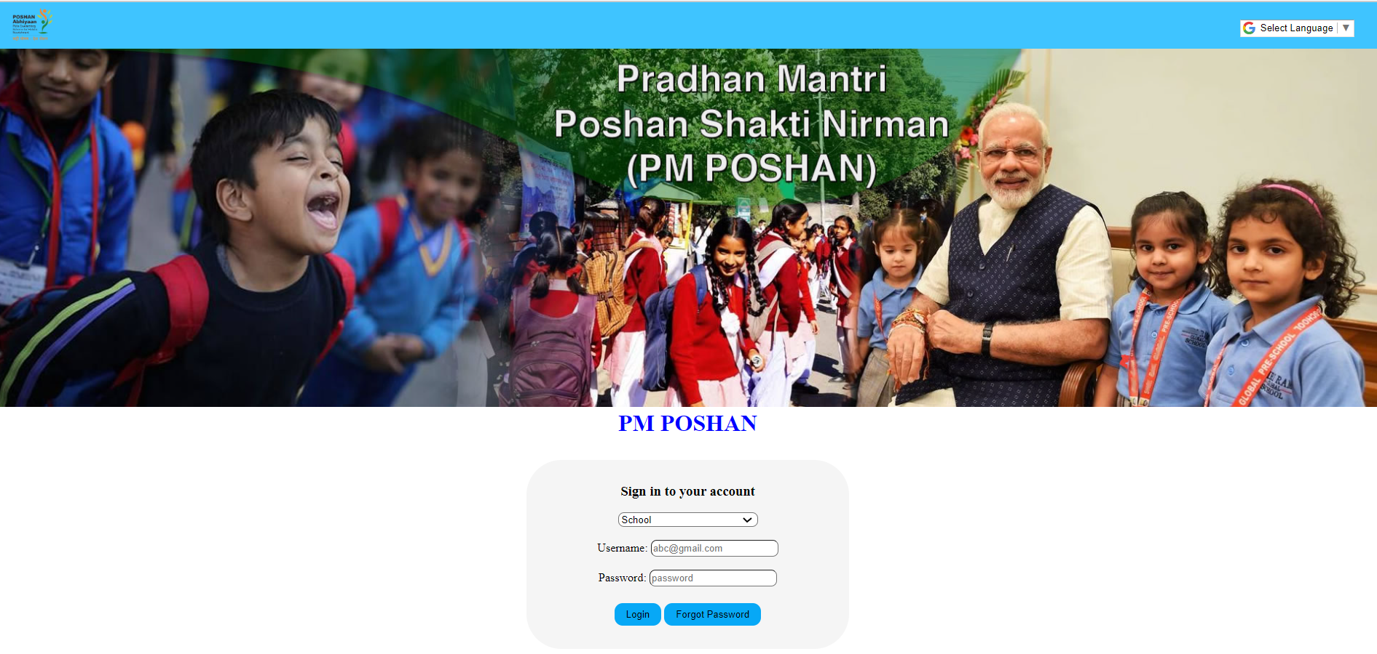
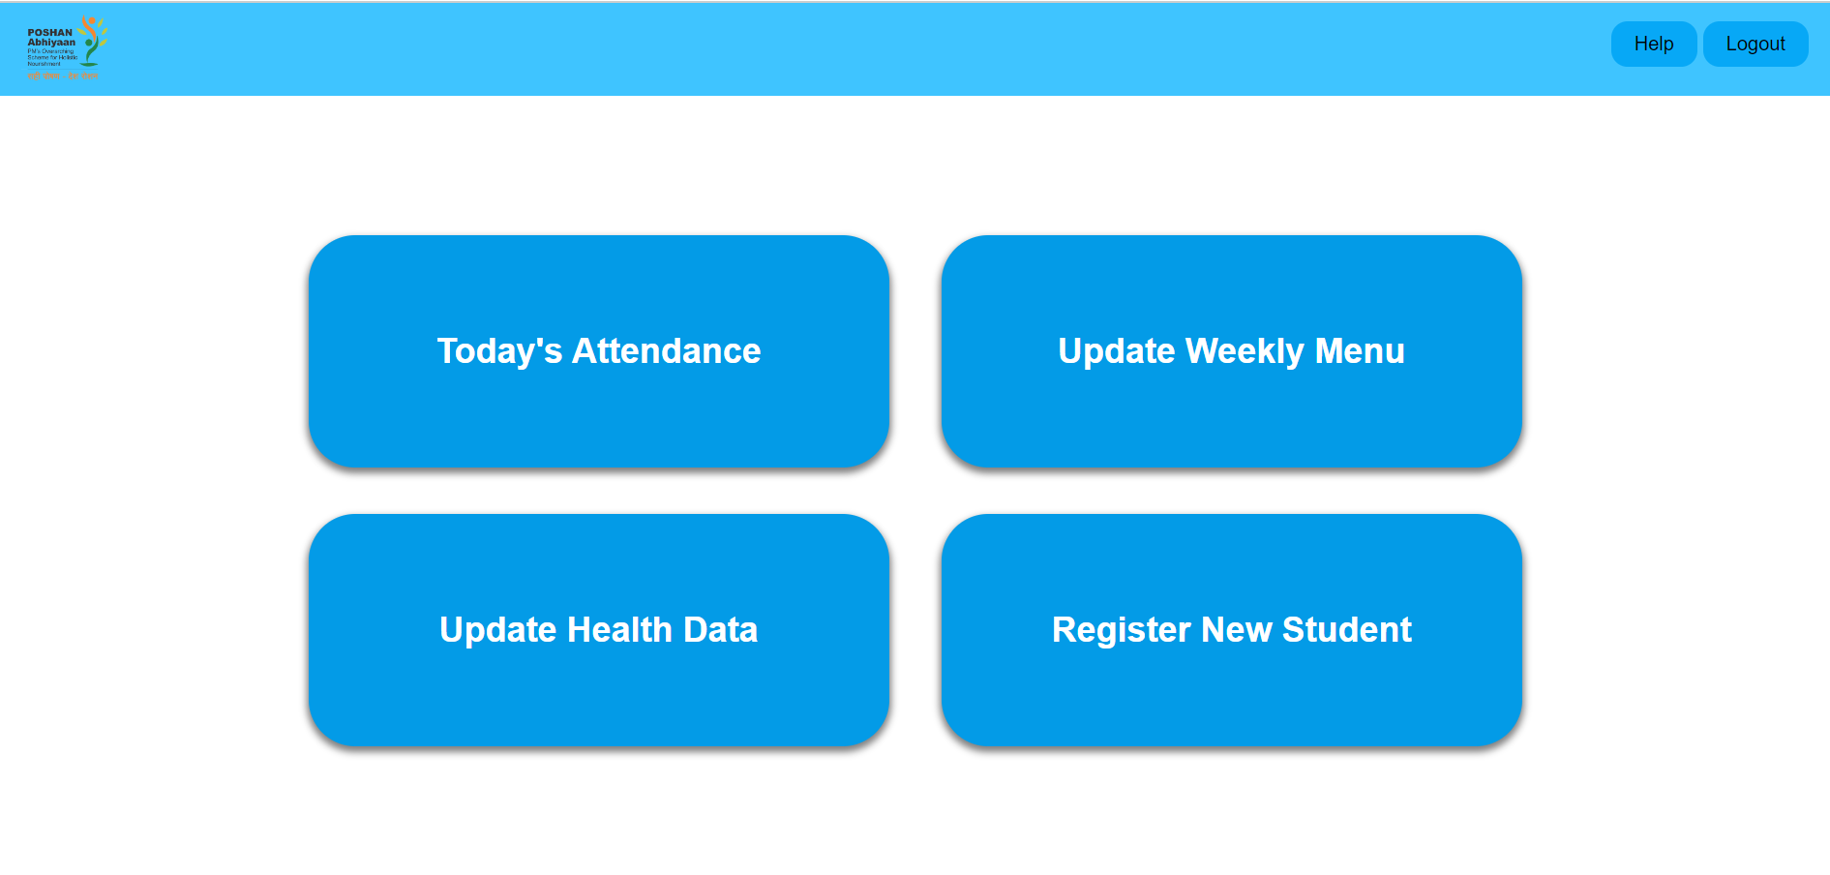
Implementation Screenshots:

Slide 9
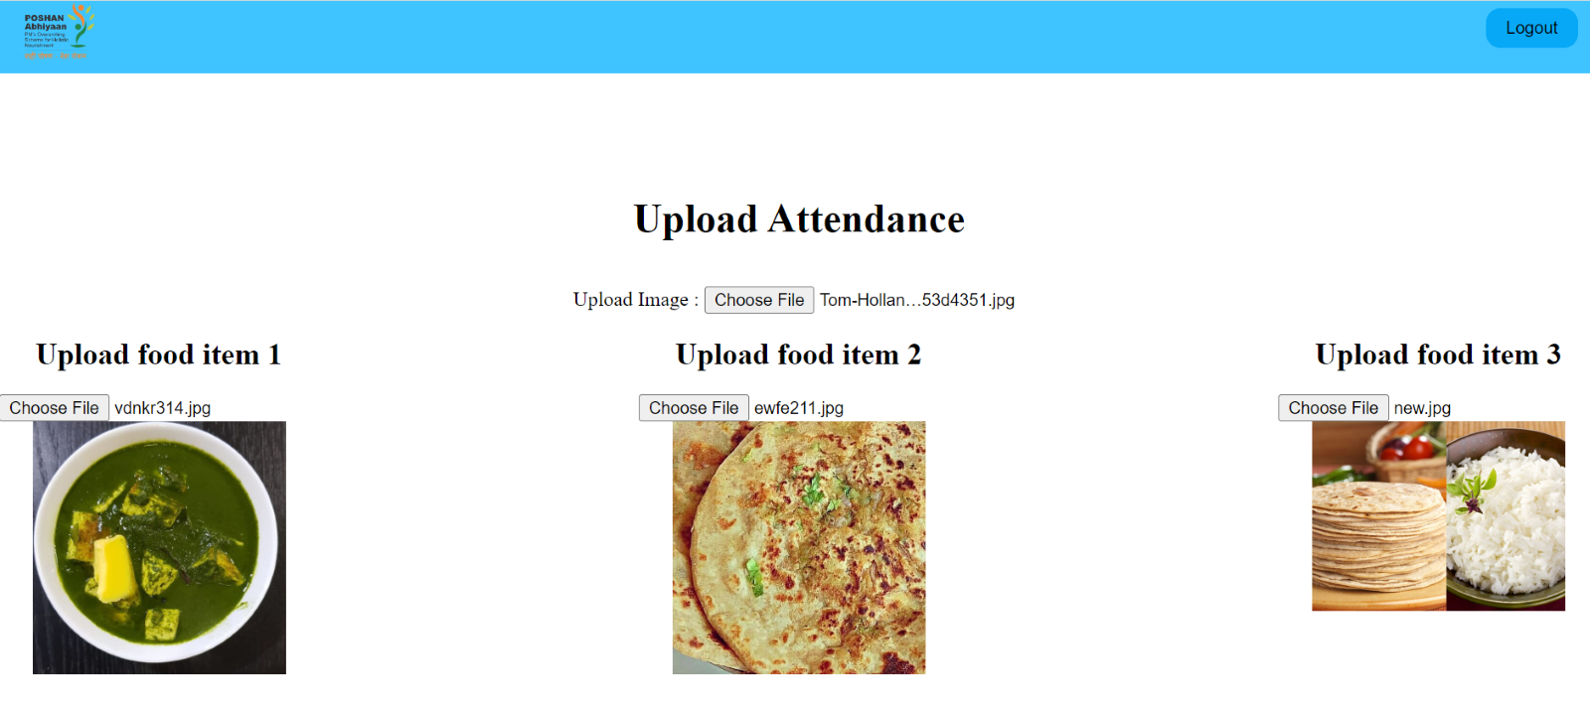
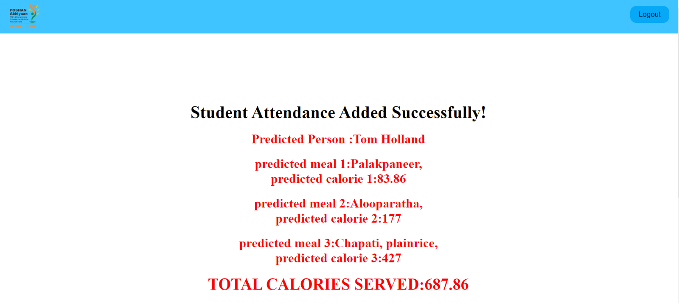

Slide 10
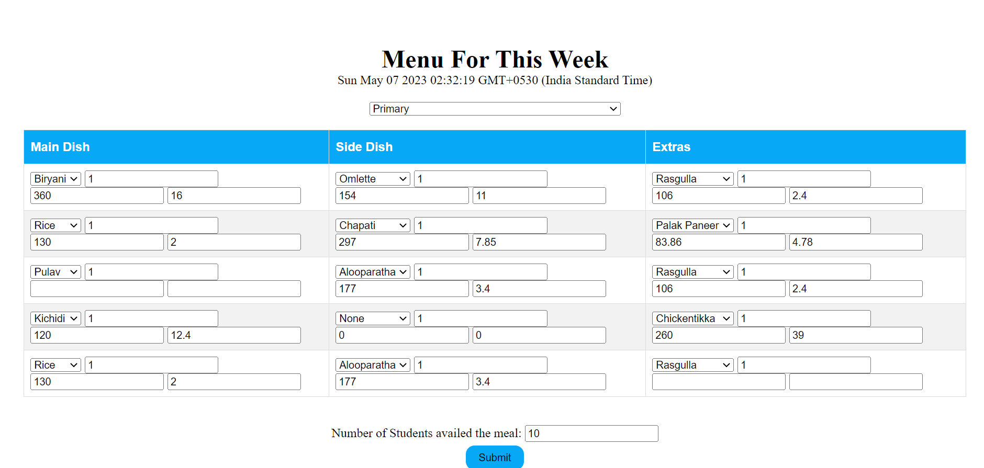

Slide 11
Pros & Cons
PROS :
Improved Nutrition: One of the key benefits of the Poshan Abhiyan is its focus on improving the nutritional status of women and children. It aims to reduce the prevalence of undernutrition.
Multi-Sectoral Approach: The Poshan Abhiyan adopts a multi-sectoral approach by involving various government departments, including health, women and child development, education, and rural development. This collaboration helps in addressing the root causes of malnutrition and ensures a comprehensive response
Real-time Monitoring: A software project can enable real-time monitoring of meal preparation, distribution, and consumption. This helps identify bottlenecks, ensure compliance with nutritional guidelines, and address any issues promptly.

Slide 12
CONS :
Implementation Challenges: Like any large-scale initiative, the Poshan Abhiyan faces implementation challenges. Ensuring effective coordination among multiple government departments, reaching remote areas, and monitoring the quality of services can be demanding, particularly in a diverse and geographically vast country like India.
Privacy and Security Concerns: Managing sensitive data, such as student information, requires strict privacy and security measures. Ensuring data protection, secure access controls, and adherence to relevant regulations becomes crucial to maintain data integrity and prevent unauthorized access.

Slide 13
Conclusion
The project is about developing an application which helps keep track of the nutrients being provided to the students as a part of the mid-day meal program. The model is able to detect the type of food item from the uploaded image and give a total calorie content. The trained model with yolov8 performs the detection on the images uploaded.

Slide 14
Future Scope :
Improv calorie estimation using instance segmentation, which will help calculate the precise amount of calories present.
We will implement it as an android application
Writing efficient algorithm which detects food items in complete plate
Including real time database consisting of real time food images and student face recognition dataset

Slide 15
References :
https://www.w3schools.com/
https://roboflow.com/
https://www.kaggle.com/
https://www.tutorialspoint.com/flask/
https://docs.ultralytics.com/models/

Slide 16
Thank You

